Slide 1
SC2002 SCE3 Group 3

Slide 2
UML Class Diagram

Slide 3
UML Sequence Diagram

Slide 4
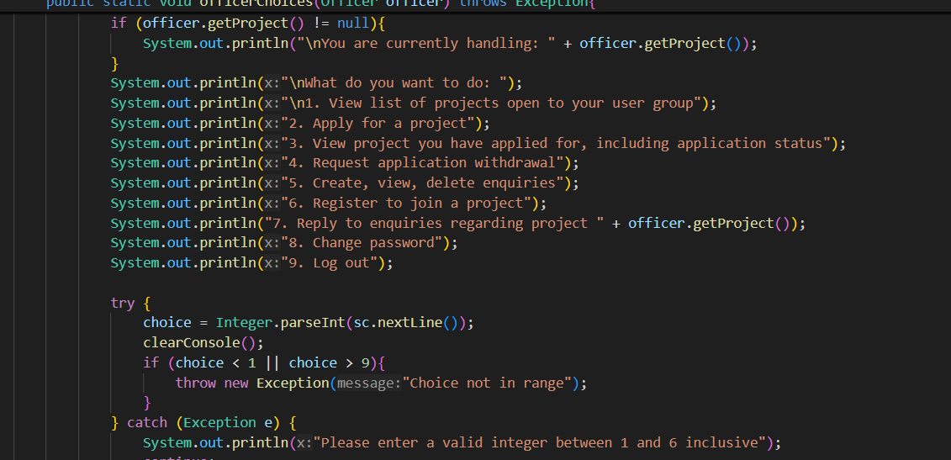
Design Consideration
Before the professor taught on SOLID principles, nested if else try statements made the code harder and harder to work on as time progressed

Slide 5
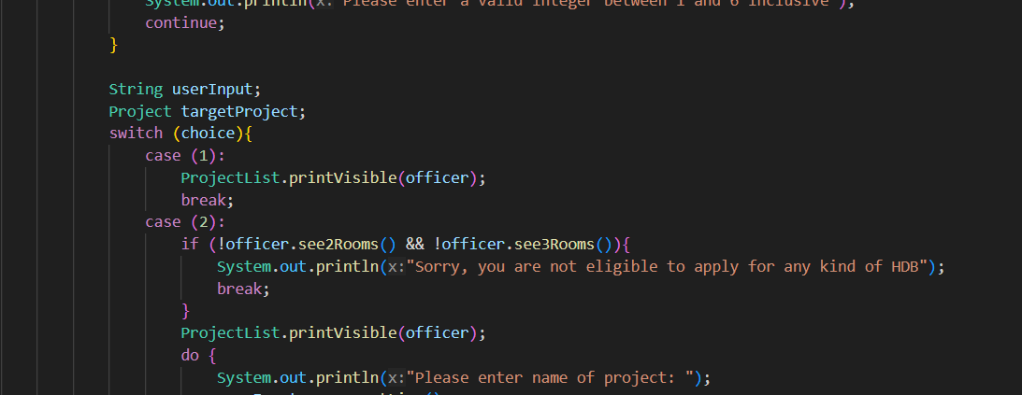
Design Consideration
Case statements made it time consuming to read through code and adjust a lot of bounds when new features added

Slide 6
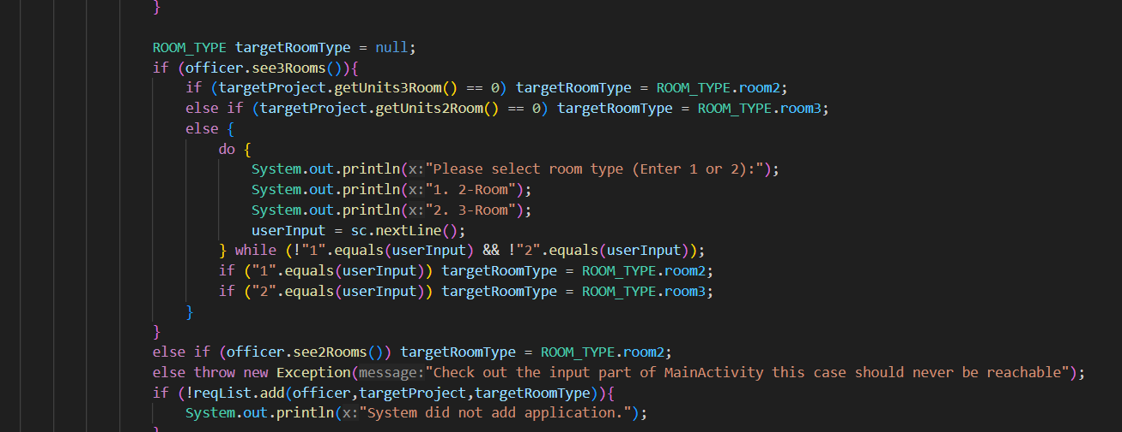
Design Consideration
Took a significant amount of time editing the Main class print and input cases compared to the implementation of the code

Slide 7
Extra features: password Hashing, Salt, Pepper

Slide 8
Extra features: Menu Stack features, for deeper nesting, if required.

Slide 9
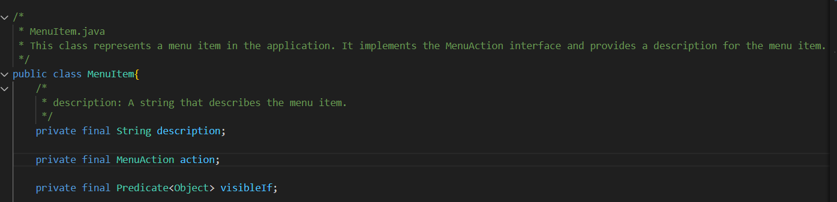
Extra features: Command Pattern
Reason: Easier to initiate

Slide 10
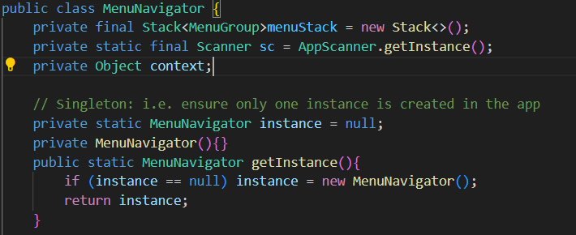
Extra features: Singleton
Reason: Some classes should have 1 global object only

Slide 11
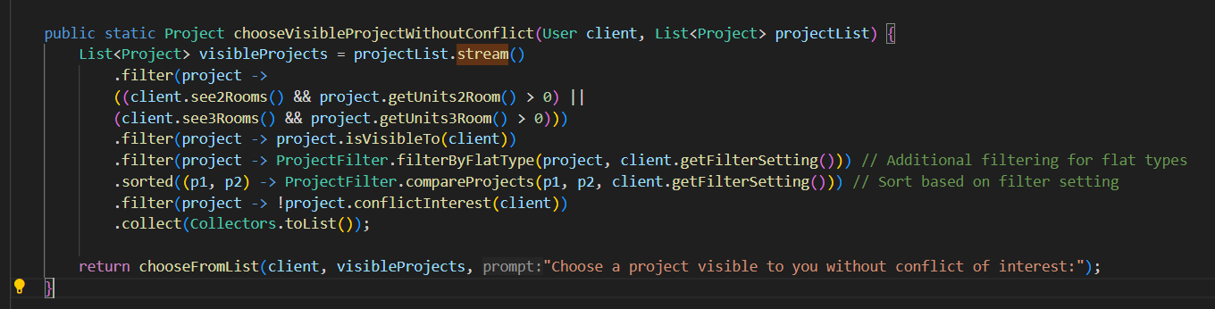
Extra features: Pipeline Pattern
Reason: streams API naturally leads to using pipeline pattern

Slide 12
Implementation Code

Slide 13
Demonstration and Report

